Slide 1
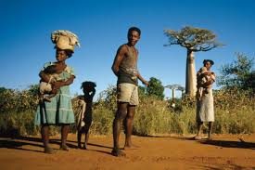
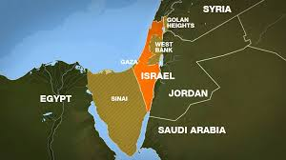
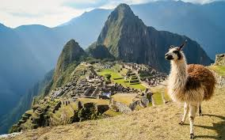
South lewis middle school summer school 2018
-The Amazing Race-
July 2- August 2
@ South Lewis Middle School
Incoming 5th Graders to 9th Graders
Location: South Lewis Middle School
Dates: July 2 – August 2
*NOTE: No classes on Fridays or 7/4
Time: 8:15 AM–11:30 AM
*Transportation Provided
*FREE Breakfast and Lunch
*Learn About China, Israel, Greece, Madagascar, and Peru
*Make salt maps
*Go on virtual tours
Call the office to register!
Middle School: 315-348-2570

